Slide 1
Sentiment Analysis on Amazon Food Review

Slide 2
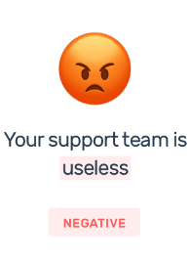

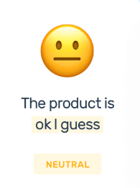
Sentiment Analysis
Sentiment analysis is a popular natural language processing (NLP) technique that is used to determine the emotional tone of text, such as positive, negative, or neutral.

Slide 3
Types of Sentiment Analysis
Graded Sentiment Analysis
If polarity precision is important to your business, you might consider expanding your polarity categories to include different levels of positive and negative:
Very positive
Positive
Neutral
Negative
Very negative
This is usually referred to as graded or fine-grained sentiment analysis, and could be used to interpret 5-star ratings in a review, for example:
Very Positive = 5 stars
Very Negative = 1 star

Slide 4
Types of Sentiment Analysis
Emotion detection
Emotion detection sentiment analysis allows you to go beyond polarity to detect emotions, like happiness, frustration, anger, and sadness.
Many emotion detection systems use lexicons (i.e. lists of words and the emotions they convey) or complex machine learning algorithms.
One of the downsides of using lexicons is that people express emotions in different ways. Some words that typically express anger, like bad or kill (e.g. your product is so bad, or your customer support is killing me) might also express happiness (e.g. this is bad ass or you are killing it).

Slide 5
Types of Sentiment Analysis
Aspect-based Sentiment Analysis
Usually, when analyzing sentiments of texts you’ll want to know which particular aspects or features people are mentioning in a positive, neutral, or negative way.
That's where aspect-based sentiment analysis can help, for example in this product review: "The battery life of this camera is too short", an aspect-based classifier would be able to determine that the sentence expresses a negative opinion about the battery life of the product in question.

Slide 6
Types of Sentiment Analysis
Multilingual sentiment analysis
Multilingual sentiment analysis can be difficult. It involves a lot of preprocessing and resources. Most of these resources are available online (e.g. sentiment lexicons), while others need to be created (e.g. translated corpora or noise detection algorithms), but you’ll need to know how to code to use them.
Alternatively, you could detect language in texts automatically with a language classifier, then train a custom sentiment analysis model to classify texts in the language of your choice.

Slide 7
Sentiment Analysis-Amazon Food
Amazon is a popular online marketplace that offers a wide range of food products to customers. The reviews left by customers on Amazon can provide valuable insights into the quality of the food products and the customer experience.
In recent years, sentiment analysis has become an important tool for analyzing Amazon food reviews. Researchers have used a variety of NLP techniques to analyze large datasets of Amazon food reviews and gain insights into customer opinions and preferences.

Slide 8
Importance of Sentiment Analysis
Sentiment analysis for the brand is very important for both parties i.e. organization and client, to increase the sale of products.
To achieve profit, by understanding the real behavior of the customer about the sale products.
Improvement of the product, quality, and sale of the product can predict the customer reviews that can be positive, negative, or neutral. By using sentiment analysis “to provide the high quality of services and also the improvement of the product’s quality” enhances the customer traffic on the selling platform. Amazon product reviews can help the customer about the same product choice and it can also help the customer for better decision making.

Slide 9
Advantages of Sentiment Analysis
The overall benefits of sentiment analysis include:
1. Sorting Data at Scale
Can you imagine manually sorting through thousands of tweets, customer support conversations, or surveys? There’s just too much business data to process manually. Sentiment analysis helps businesses process huge amounts of unstructured data in an efficient and cost-effective way.
2. Real-Time Analysis
Sentiment analysis can identify critical issues in real-time, for example is a PR crisis on social media escalating? Is an angry customer about to churn? Sentiment analysis models can help you immediately identify these kinds of situations, so you can take action right away.
3. Consistent criteria
It’s estimated that people only agree around 60-65% of the time when determining the sentiment of a particular text. Tagging text by sentiment is highly subjective, influenced by personal experiences, thoughts, and beliefs.
4. Horizontal Integration
By using a centralized sentiment analysis system, companies can apply the same criteria to all of their data, helping them improve accuracy and gain better insights.
5. Numerous Applications
The applications of sentiment analysis are endless. So, to help you understand how sentiment analysis could benefit your business, let’s take a look at some examples of texts that you could analyze using sentiment analysis.
6. Useful Insights
Then, we’ll jump into a real-world example of how Chewy, a pet supplies company, was able to gain a much more nuanced (and useful!) understanding of their reviews through the application of sentiment analysis.

Slide 10
Sentiment Analysis Algorithms
Sentiment analysis algorithms fall into one of three buckets:
Rule-based: these systems automatically perform sentiment analysis based on a set of manually crafted rules.
Automatic: systems rely on machine learning techniques to learn from data.
Hybrid systems combine both rule-based and automatic approaches.

Slide 11
Rule-based approach
Usually, a rule-based system uses a set of human-crafted rules to help identify subjectivity, polarity, or the subject of an opinion.
These rules may include various NLP techniques developed in computational linguistics, such as:
Stemming, tokenization, part-of-speech tagging and parsing.
Lexicons (i.e. lists of words and expressions).
Here’s a basic example of how a rule-based system works:
Defines two lists of polarized words (e.g. negative words such as bad, worst, ugly, etc and positive words such as good, best, beautiful, etc).
Counts the number of positive and negative words that appear in a given text.
If the number of positive word appearances is greater than the number of negative word appearances, the system returns a positive sentiment, and vice versa. If the numbers are even, the system will return a neutral sentiment.
Rule-based systems are very naive since they don't take into account how words are combined in a sequence. Of course, more advanced processing techniques can be used, and new rules added to support new expressions and vocabulary. However, adding new rules may affect previous results, and the whole system can get very complex. Since rule-based systems often require fine-tuning and maintenance, they’ll also need regular investments.

Slide 12
Automatic approaches
Automatic methods, contrary to rule-based systems, don't rely on manually crafted rules, but on machine learning techniques. A sentiment analysis task is usually modeled as a classification problem, whereby a classifier is fed a text and returns a category, e.g positive, negative, or neutral.
Here’s how a machine learning classifier can be implemented:

Slide 13
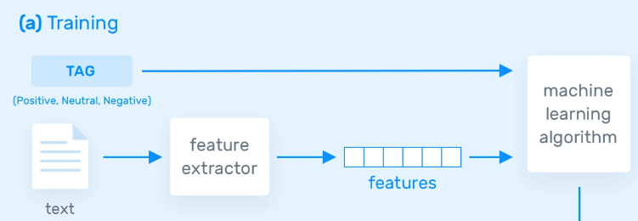
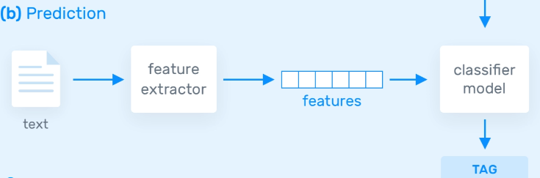
How does Sentiment Analysis work?

Slide 14
How does Sentiment Analysis work?
The Training and Prediction Processes
In the training process (a), our model learns to associate a particular input (i.e a text) to the corresponding output (tag) based on the test samples used for training. The feature extractor transfers the text input into a feature vector. Pairs of feature vectors and tags (e.g positive, negative, or neutral) are fed into the machine learning algorithm to generate a model.
In the prediction process (b), the feature extractor is used to transform unseen text inputs into feature vectors. These feature vectors are then fed into the model, which generates predicted tags (again, positive, negative, or neutral).
Feature Extraction from Text
The first step in a machine learning text classifier is to transform the text extraction or text vectorization, and the classical approach has been bag-of-words or bag-of-ngrams with their frequency.
More recently, new feature extraction techniques have been applied based on word embeddings (also known as word vectors). This kind of representations makes it possible for words with similar meaning to have a similar representation, which can improve the performance of classifiers.

Slide 15
Approach to Sentiment Analysis
One popular approach to sentiment analysis is the use of machine learning algorithms such as Naive Bayes, Support Vector Machines (SVM), and Convolutional Neural Networks (CNN).
These algorithms are trained on labeled datasets of Amazon food reviews to classify new reviews as positive, negative, or neutral.
Machine learning-based sentiment analysis has been shown to be effective in identifying the sentiment of Amazon food reviews and providing insights into customer opinions and preferences.

Slide 16
Approach to Sentiment Analysis
Naïve Bayes: a family of probabilistic algorithms that uses Bayes’s Theorem to predict the category of a text.
Linear Regression: a very well-known algorithm in statistics used to predict some value (Y) given a set of features (X).
Support Vector Machines: a non-probabilistic model which uses a representation of text examples as points in a multidimensional space. Examples of different categories (sentiments) are mapped to distinct regions within that space. Then, new texts are assigned a category based on similarities with existing texts and the regions they’re mapped to.
Deep Learning: a diverse set of algorithms that attempt to mimic the human brain, by employing artificial neural networks to process data.

Slide 17
Sentiment Lexicons Approach
Another approach to sentiment analysis is the use of sentiment lexicons. A sentiment lexicon is a collection of words and phrases that are annotated with their corresponding sentiment polarity (positive, negative, or neutral).
Using a sentiment lexicon, we can assign a sentiment score to each Amazon food review by counting the number of positive, negative, and neutral words and phrases in the review.
Sentiment lexicon-based sentiment analysis is relatively simple and computationally efficient but may be less accurate than machine learning-based approaches.

Slide 18
Improving Accuracy of Sentiment Classification
Text preprocessing techniques such as tokenization, stemming, and stop word removal are also commonly used in sentiment analysis to improve the accuracy of sentiment classification.
Tokenization involves breaking down the text into individual words or tokens, stemming involves reducing words to their root form, and stop word removal involves removing common words such as "the" and "a" that do not carry much meaning.
Overall, sentiment analysis on Amazon food reviews can provide valuable insights into customer opinions and preferences. By analyzing large datasets of Amazon food reviews using machine learning algorithms, sentiment lexicons, and text preprocessing techniques, researchers can identify key themes and topics that customers are discussing in their reviews. For example, freshness, packaging, and shipping time are common topics in Amazon food reviews.

Slide 19
Conclusion
Sentiment analysis is a powerful tool for analyzing customer feedback on Amazon food products. The insights gained from sentiment analysis can help food manufacturers and online retailers make informed decisions about product quality, customer service, and marketing strategies. As the popularity of online marketplaces like Amazon continues to grow, sentiment analysis will become an increasingly important tool for understanding customer opinions and preferences

